Slide 1
Proloquo2Go 2.02
Presented By:
Carolyn Rouse
Assistive Technology Department
Special Student Services
10.1.12

Slide 2
Class Outline
Before Lunch
Setting up iPad and Proloquo
Introduction to users
How to store buttons and pages
Customizing the user
Programming Buttons
Programming pages
***Lunch
After Lunch
How to think about programming pages and how to teach the student to use the device
What you can and cannot expect the device to do
Programming pages to help the student learn to use it
More Programming
How to back up and restore users
Home

Slide 3
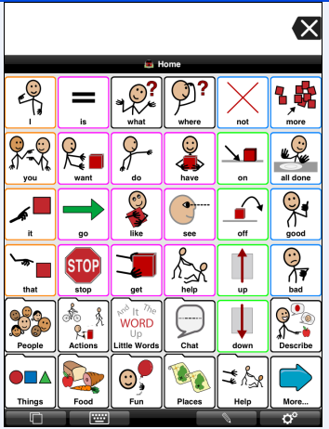
Understanding how the screens work

Slide 4
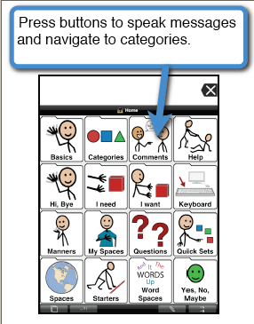
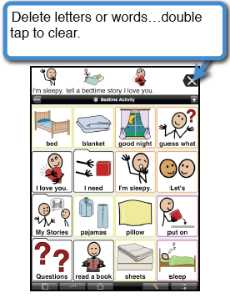
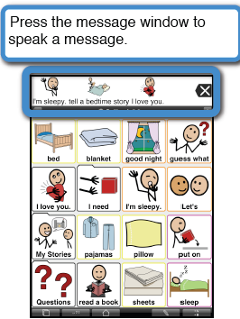
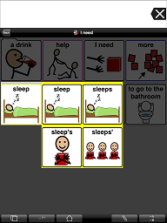
Take a minute to explore the device.
Also take note of the Vocabulary Map
we gave you.
Holding a button will give you the verb or noun forms of the word.

Slide 5
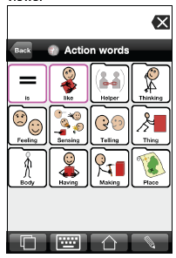
Navigation Buttons
Page Title
Always tells you where you are
Home Button
Always takes you to the home screen
Back Button
Takes you to the previous screen

Slide 6
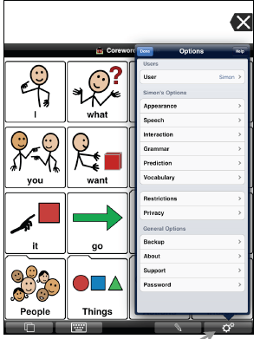
More Screen Buttons
Keyboard
Brings up an ABC keyboard
View Screens
Brings up 3 view screens
Settings
Takes you to the control buttons

Slide 7
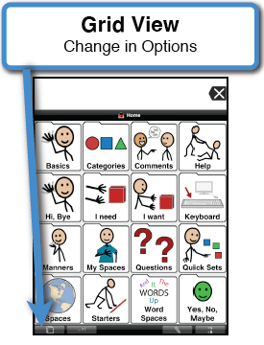
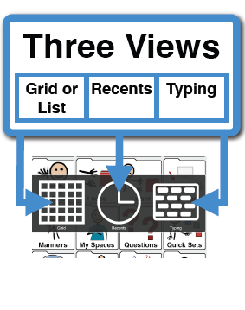
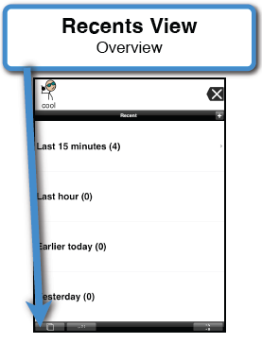
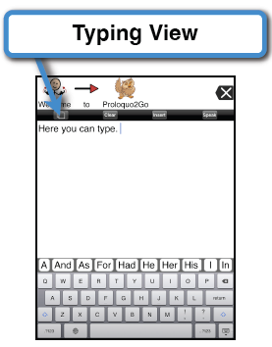
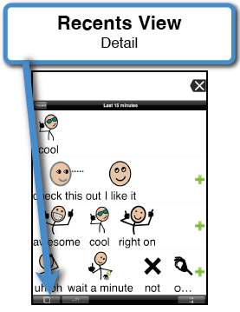
To Change Views
3 Views
Note: using the keyboard
In this view is qwerty and
has word prediction.
The keyboard accessed at
the bottom of the screen is
an ABC arrangement with
no word prediction
Grid View or Communication Board
This item can be
turned off under
options/restrictions

Slide 8
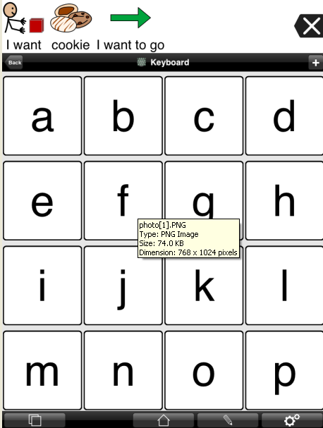
2 Keyboards on Proloquo
Notice it’s qwerty
Key arrangement
And has word and
Phrase prediction
This keyboard can be
turned off under
options/restrictions
Notice this ABC arrangement requires
you to scroll for all of the letters and has
No word prediction,
This keyboard can be
turned off under
options/restrictions

Slide 9
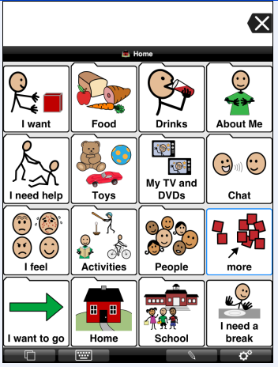
Proloquo Vocabulary Sets
1.Core Word is built to allow the student to construct grammatically correct sentences.
Vocabulary is access through grammatical categories can have 9-64 buttons on a page with scrolling
2. Basic Communication consists of basic
page sets for requesting. This is good for
the very early communicator who is not
putting pictures together in sentences or
only using very simple sentences.
You can have 9-64 pictures on a page.
3. Blank Vocabulary totally blank not even
blank buttons
Note: If you
already have a
User you are using
and you have done
programming on it,
adding a user will
not lose the one
you have.

Slide 10
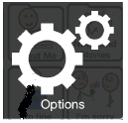
Proloquo Controls

Slide 11
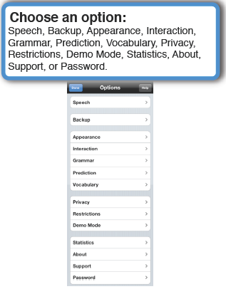
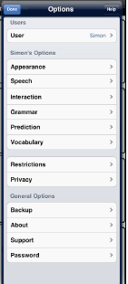
Options Button on the bottom right hand corner of the Proloquo screen
User
User, Appearance, Speech, Interaction, Grammar,
Prediction, Vocabulary, Restrictions, Privacy,
Backup, About, Support, Password
Note: You can hide this function
By tapping on Proloquo in the
General iPad settings and
turning it off.

Slide 12
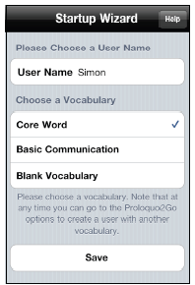
To Set Up a New User The first time you open Proloquo2.0 it will give you this start up screen to set up a new user
Type in the name of the user
Then pick the vocabulary set you want to use
Then hit save
The basic screens will then load. You will then need to customize it a bit further.

Slide 13
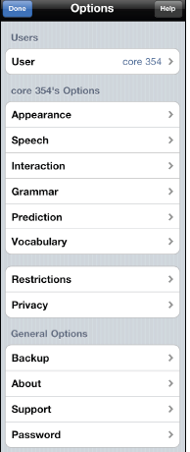
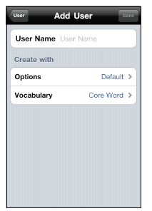
To Add a new User
RED ALERT If you don’t
tell it what vocabulary
set to use it will
automatically be the
core user.
Click the option icon at the bottom of the screen
Click User under options
Add the user’s name
Choose the vocabulary set

Slide 14
Setting Up the User
Set up your student with a Core vocabulary and a Basic vocabulary so you can see which user would be best
Name them
“Student name Core” ex. John Core
“Student name Basic” ex. John Basic
Then look and decide which user you like best for your student.

Slide 15
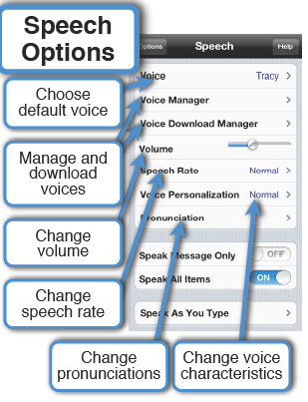
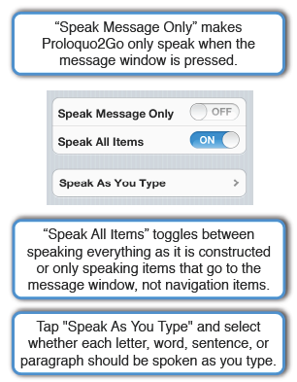
To Change the voice
Note: Here is the 4th way to
Turn off the volume!!

Slide 16
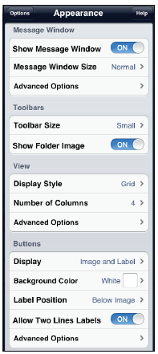
Appearance
Message window options allow you to whether
to show the message or change the size of the
Window. Advanced options allow you to
change color text position and whether you
want it to display text or pictures
Toolbar options allow you to change the tool
bar size and whether you want a icon on it.
The View Options allow you to use a list rather
than buttons. It also allows you to set the
number of pictures in the columns or rows
(under advanced options) as well as how close
the pictures are and the color of the background.
The Button Options allow you to choose whether
how you want the label and/or picture. Advanced
Options allows you to change the color of the
Buttons and whether you want the link buttons
To appear as folders
Note: you can change the appearance of individual
Buttons (see programming buttons section)

Slide 17
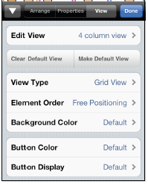
To customize Buttons
Under appearance in the options menu, you can customize all the buttons in general.
Under the view Tools or the button tools you can customize individual buttons. (We will cover this more in the section on customizing buttons.)

Slide 18
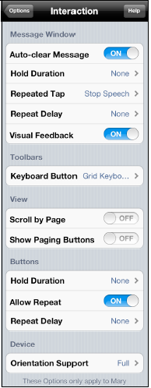
Interaction (or Access)
Auto-clear Message (on) will automatically clear the message
When the next button is tapped.
Hold Duration (for message window or for buttons in general,
see below) requires users to hold their finger down for a
specified time before the message is triggered.
Repeated Tap on the message window can be set to be ignored,
restart speech, stop speech, or to pause speech.
Repeat Delay (for message window only or for buttons in
general, see button section) works like turning off the key
repeat function
Visual feedback makes the message expand a bit when
being spoken
Keyboard button allows you to lock it into the keyboard page.
Scroll by Page allows you to let the page scroll freely or not.
Show Paging Buttons Adds Page up/down by button rather
than by scrolling,
Allow Repeat won’t let the student to hit a button multiple times.
Orientation support allows
The screen to rotate or not.

Slide 19
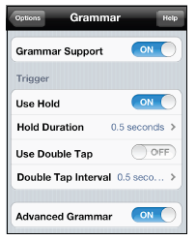
Grammar
Grammar support allows you to turn the morphology ( i.e. plurals, verb tense etc.)off or on.
Trigger options allows you to set what you want to use to bring the grammar selections up .
Advanced Grammar allows more conjunctions and possessive to be displayed when the grammar screen comes up

Slide 20
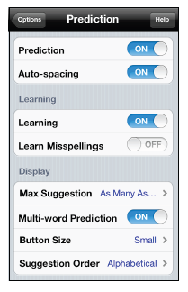
Word Prediction on the keyboard view only
You can turn off whether you want the word prediction at all and whether you want the device to automatically add spaces between words.
Learning. The prediction program is constantly learning to better adapt to the user. Learning allows this to happen. Learn misspellings in the off position does not allow the program to learn words that do not match the spelling in it’s dictionary
Display allows you to change the word prediction display. You can change the number of suggestions, whether you want it to predict phrases, the size of the prediction buttons and the order of the word guesses.
Word prediction

Slide 21
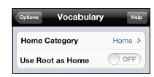
Vocabulary
The Vocabulary Option simply lets you pick what page you want to use as the
Main (home) screen.

Slide 22
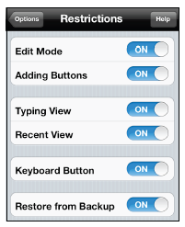
Proloquo Restrictions
This is how you limit the
functions of the device
you want the student to
have access to by turning
functions off.
Turning typing view and recent
view off will eliminate those views
When the view button is tapped.
Turning the keyboard button off
will take the ABC keyboard at the
bottom of the screen away
Note: Restore from back up will be
Discussed in the back up section

Slide 23
Privacy, About, Support and Password
Privacy will clear recents as you type so there is not a
Record of what you have said.
About tells you the version of the software.
Support links you to the website where you can ask
Questions and troubleshoot.
Password allows you to require a password before
the options button can be accessed.
Note: The default password is:
Vygh-phi-rhy-mo
Note: Back up will be discussed later.

Slide 24
Let’s take a few minutes to decide how best to set up the device for your student.

Slide 25
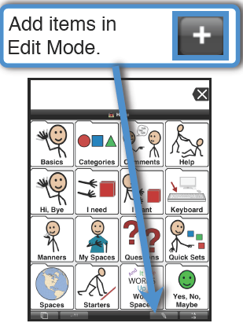
How to Program a Button
A

Slide 26
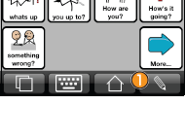
3 sets of editing tools
Arrange
Properties
View
View is a quick way to
Change how many
Buttons are on a page
By changing the number
Of columns.
Arrange are tools
You need to program
New buttons,
Add pages, swap button
And put buttons in storage
Properties are the tools
you need to edit an
existing button

Slide 27
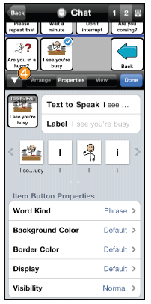
Editing Buttons
Properties View Tools
Let’s you change:
Message what you want the button to say ,
Label what you want written at the top of the button or
the picture on the Button.
Note:
You can change the button or background color, whether
you want text/picture or whether you want the picture dimmed or hidden.
Word kind let’s you pick how
you want the device to treat
your word grammatically

Slide 28
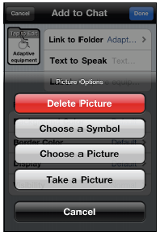
Putting Pictures on Buttons
Delete picture will leave only the word on the button
Choose a symbol brings up a screen that allows you to type in the name of a picture and choose a picture form Proloquo to use
Choose a picture allows you to use a picture already on your iPad
Take a picture allows you to take a photo with your iPad and will automatically resize and use it on the button

Slide 29
Let’s edit the “my name is” button
On the core Vocabulary tap people
Tap the pencil at the bottom
then tap the name picture
Then bring up the property tools
Add the message “My name is______”
Add the name as a label
Change the picture by touching the picture in the tools window.
This will allow you to pick a new symbol, use a real photograph already on the device, take a new picture to use, or delete the picture and have only the name.
Note : you can also change
how the button looks or if
you want it hidden here.

Slide 30
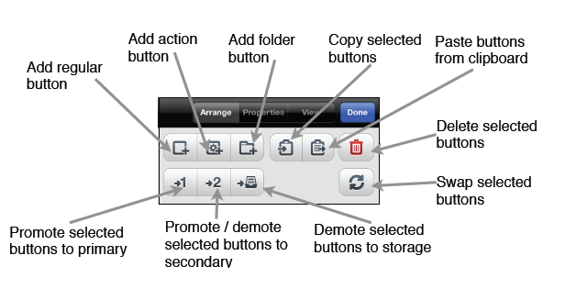
Editing Buttons
Arrange View Tools
Use a add a regular button to add another
message button on your page.
Use an Action button when you want the
button to do something like add text to the
message window, clear message window,
speak message window or text
Use add a Folder button to create
A button that will take you to a whole
New blank page where you can then
Add buttons

Slide 31
To add a New Button or to Create new pages Go to Arrange Buttons
You can also copy and paste buttons from
One screen to another by selecting the
Button hitting copy, going to the new page
Hitting paste. Then let’s delete the new
button we just added
You can swap buttons by tapping the
Buttons you want to swap and then
Hitting the swap button
You can also delegate pictures to primary
or secondary vocabulary which sets the picture
Prominently or on the next page or to hide
Buttons completely by putting them in storage.

Slide 32
How to rearrange the buttons/items
1. Go to edit mode (the pencil)
then hold the picture you want to move until it pulses. Then you can move the picture around.
or
2. Use the Swap button in the Arrange Tools

Slide 33
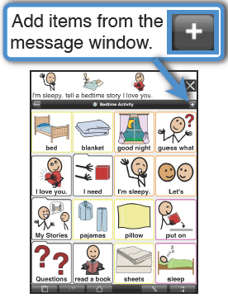
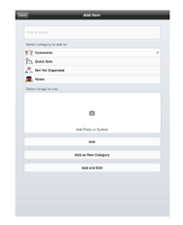
You can create buttons on the spot by putting message in message window and clicking the +
Create the message you can in your button in the message window.
Then hit the small + sign on the upper menu bar.
It will create the button in the customize window
Make any changes you would like
Then click add

Slide 34
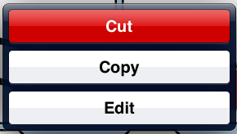
To Delete a Button/Item
Hit the pencil icon
Hit the button you want to delete
Hit cut
The button will vanish

Slide 35
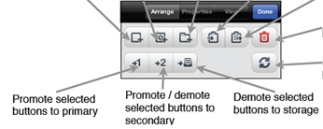
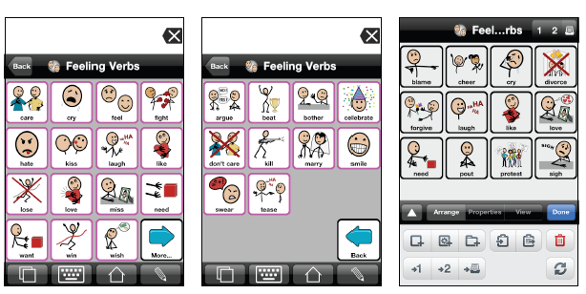
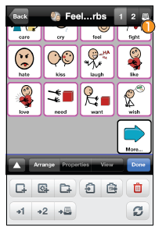
Prioritizing vocabulary
Primary Secondary Storage
1st page 2nd page hidden
Secondary
Primary
Storage
To access stored buttons, in the edit menu, “arrange tools”
Click the button on the upper right hand corner. From the screen
you want the button to appear on, make it a primary or secondary
button to take it out of storage.

Slide 36
Let’s Take a minute to make adjustments to the pictures already on the device

Slide 37
How to make a new Page

Slide 38
Let’s try making a new page
Under the Arrange tools,
Hit the folder button. This will be the link button to you new page
Program how you want your link button to look.
Then exit your editing tools by hitting done.
When you are finished, hit the folder button you just made and see where it takes you.
This is a blank page, you will need to go to edit and add regular buttons on this page
just as you did before.

Slide 39
Let’s try putting a folder for manners on the food page

Slide 40
Editing Buttons
View tools
Let’s you change
The color, size or
Order of the buttons
It will also allow you
To display the buttons
As a list or buttons

Slide 41
Now let’s work on customizing what is already on the device.

Slide 42
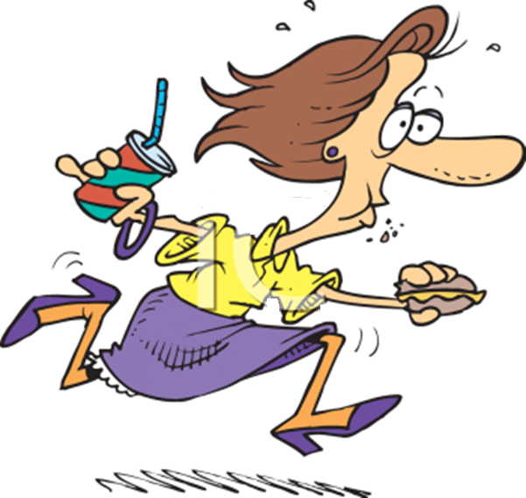
Lunch

Slide 43
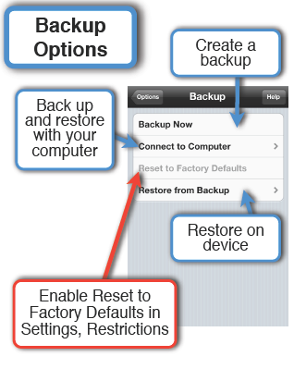
How to Back up the Device

Slide 44
To back up Proloquo
Step 1 Make a folder on the desktop of your computer and name it proloquo back ups
Step2 Turn on iTunes if it wants to update it do that first.
Step 3.plug your iPad into the computer using the USB cord on your charger.

Slide 45
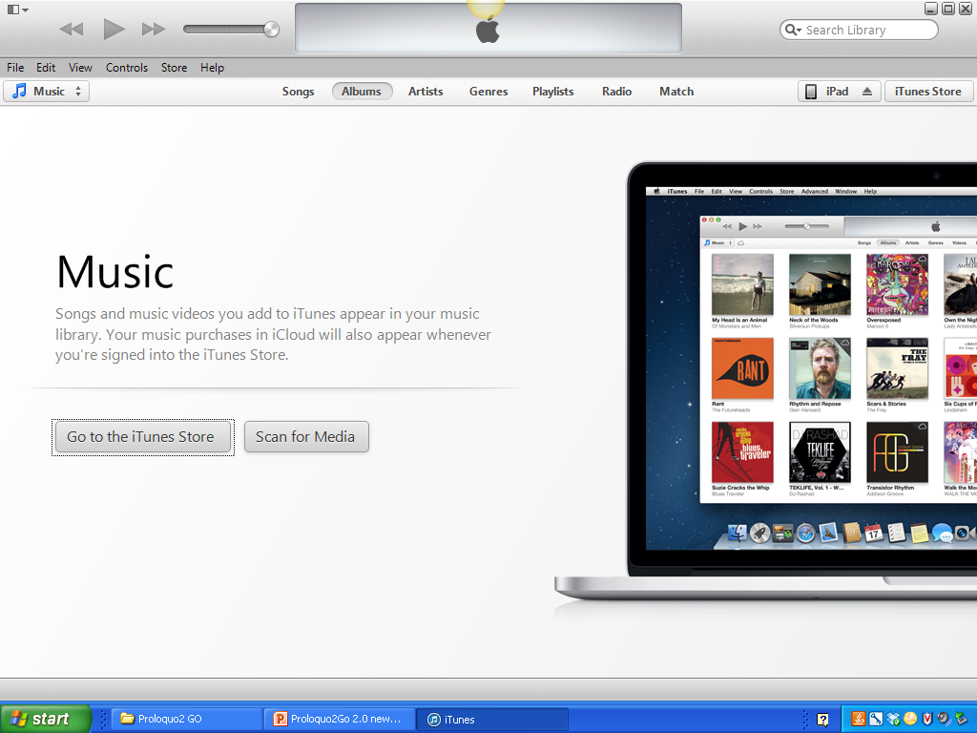
When you open iTunes the screen will look like this.
Notice the ipad on the top right of the screen
Click
the iPad
Button.

Slide 46
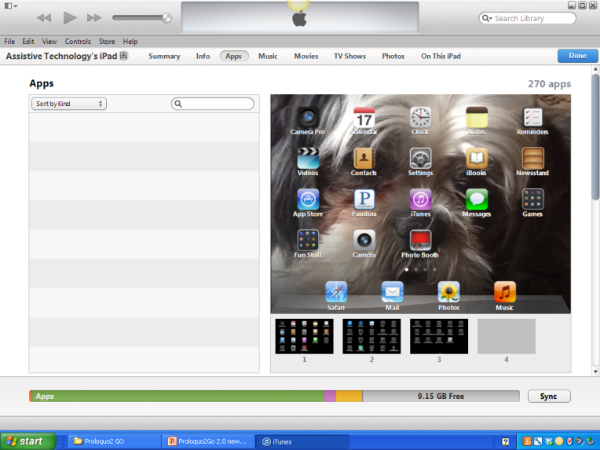
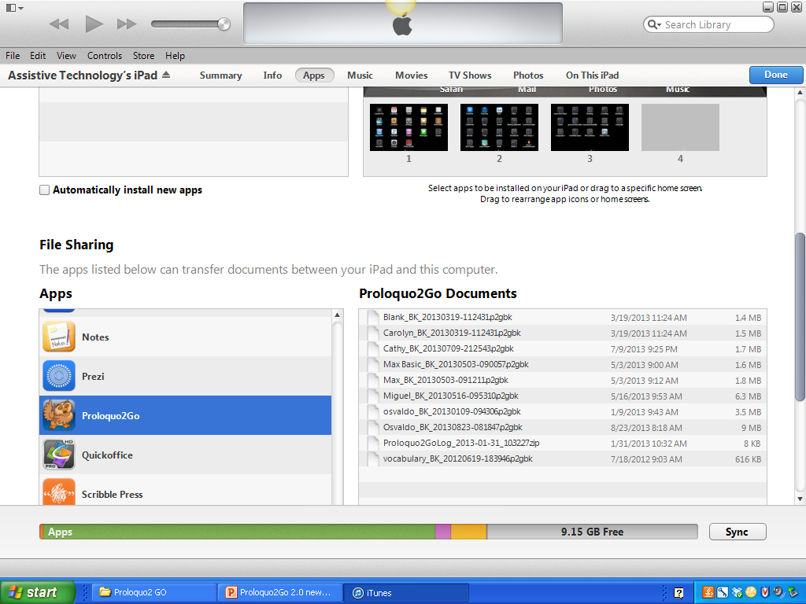
Click the Apps button
Scroll down the apps until you find Proloquo and click on it
You will see the users listed

Slide 47
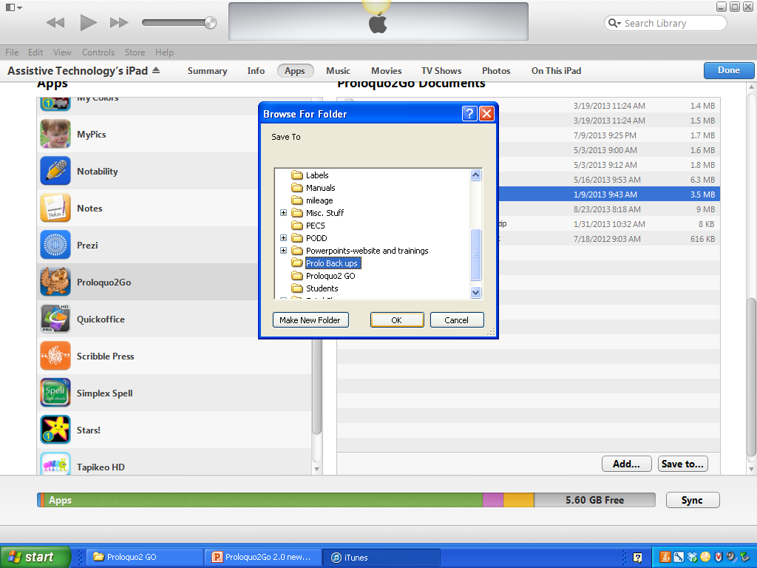
Click on the user you want to back up
Click on
“Save as”
Pick the folder you made named Prolo back ups and say ok
You have just backed up
Your device!!

Slide 48
To Restore your programming from a back up

Slide 49
Before you begin be sure you have a user already named on your iPad. Don’t worry what the user looks like, when you restore the back up it will copy over everything in this user.
Then open iTunes and plug your iPad to the computer

Slide 50
When you open iTunes the screen will look like this.
Notice the ipad on the top right of the screen
Click
the iPad
Button.

Slide 51
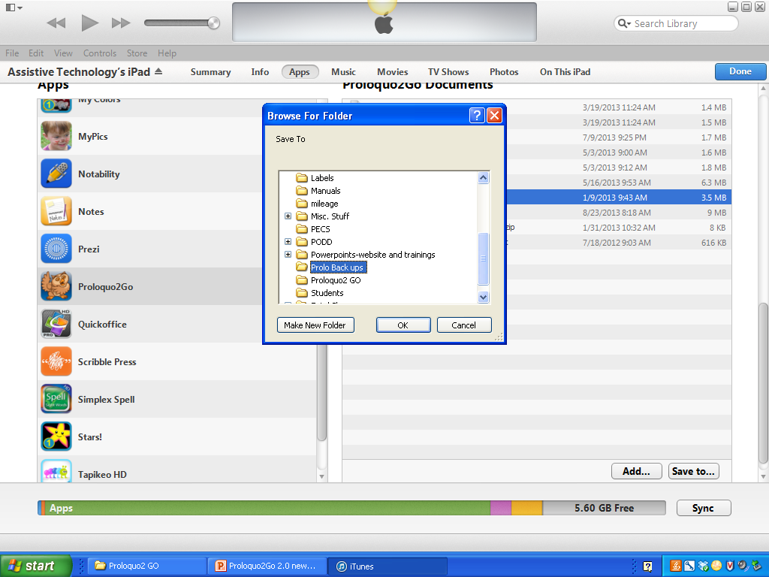
Click the Apps button
Scroll down the apps until you find Proloquo and click on it
You will see the users listed
If the use is not listed hit the Add button and open your back up folder
And select the user you want to add

Slide 52
On the iPad
Open Proloquo
Click on “Options”
Click on Back up
Click import backups
Select the user from your computer
Select the user you want to overwrite and say ok
When you open up the user you selected to overwrite the program should be there.

Slide 53
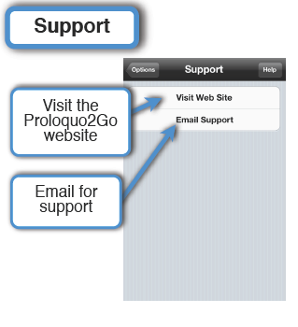
Support
call or email your area lead.
Or send an email under the support section on the proloquo website. They are very quick at answering you back.

