Slide 1
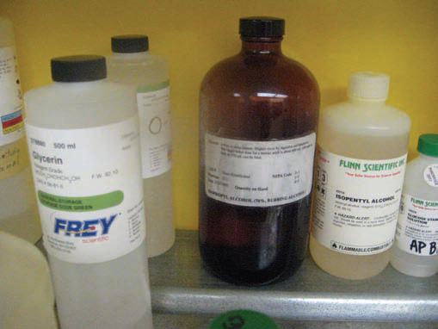
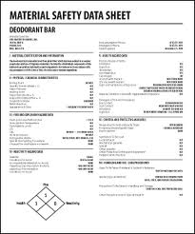
Hazard Communication Standard Updates
Introduction to Globally Harmonized System (GHS)
Label Elements and Safety Data Sheets (SDS)

Slide 2
Why is Hazard Communication Important?
Currently there are more than 650,000 chemical products on the market
-Hundreds of new chemicals are being introduced annually
About 32 million workers are exposed to safety and health hazards from these chemicals daily

Slide 3
Why did OSHA revise the Hazard Communication Standard?
Harmonized definitions of hazards
Specific criteria for labels
Harmonized format for safety data sheets
Reduce confusion & improve comprehension of hazard
Help to address literacy problems

Slide 4
EFFECTIVE DATES
The table below summarizes the phase-in dates required under the revised Hazard Communication Standard
Effective Completion Date | Requirement(s) | Who
December 1, 2013 | Train employees on the new label elements and safety data sheet (SDS) format. | Employers
June 1, 2015 December 1, 2015 | Compliance with all modified provisions of this final rule, except: The Distributor shall not ship containers labeled by the chemical manufacturer or importer unless it is a GHS label | Chemical manufacturers, importers, distributors and employers
June 1, 2016 | Update alternative workplace labeling and hazard communication program as necessary, and provide additional employee training for newly identified physical or health hazards. | Employers
Transition Period to the effective completion dates noted above | May comply with either 29 CFR 1910.1200 (the final standard), or the current standard, or both | Chemical manufacturers, importers, distributors, and employers

Slide 5
LABEL EXAMPLE

Slide 6
LABEL REQUIREMENTS
Product identifier
Chemical name, code, batch number, etc.
Signal word – Hazard Severity
Danger or Warning
Hazard statement(s)
Nature of the hazard(s) of the chemical
Pictogram(s)
Precautionary statement(s)
Name, address, and phone number of the manufacturer, distributor, or importer

Slide 7
LABELING SYSTEMS
NFPA/HMIS systems and the GHS system are inverse
NFPA/HMIS recognizes 0 as a minimal hazard up to 4 for severe hazard
Under GHS classification 5 is considered a minimal hazard, category 1 is a severe hazard
No 0 category under GHS
GHS hazard category ratings are not typically shown on a label and will be only seen on the Safety Data Sheet
All containers must be labeled

Slide 8
HCS PICTOGRAMS & HAZARDS
FLAME OVER CIRCLE
CORROSION
Oxidizers
Skin Corrosion/Burns
Eye Damage
Corrosive to Metals

Slide 9
HCS PICTOGRAMS & HAZARDS CONT.
EXCLAMATION MARK
EXPLODING BOMB
Irritant (skin & eyes)
Skin Sensitizer
Acute Toxicity
Narcotic Effects
Respiratory Tract Irritant
Hazardous to Ozone Layer (Not Mandatory)
Explosives
Self-Reactives
Organic Peroxides

Slide 10
HCS PICTOGRAMS & HAZARDS CONT.
SKULL & CROSSBONES
FLAME
Acute Toxicity (fatal or toxic)
Flammables
Pyrophorics
Self-Heating
Emits Flammable Gas
Self-Reactives
Organic Peroxides

Slide 11
HCS PICTOGRAMS & HAZARDS CONT.
GAS CYLINDER
HEALTH HAZARDS
Gases Under Pressure
Carcinogen
Mutagenicity
Aspiration Toxicity
Respiratory Sensitizer
Target Organ Toxicity
Reproductive Toxicity

Slide 12
HCS PICTOGRAMS & HAZARDS CONT.
ENVIRONMENT
Aquatic Toxicity

Slide 13
LABELING SYSTEMS (Cont)
These different labeling systems, currently used in industry, may still be used for secondary container labeling
NFPA
HMIS
ANSI
DOT

Slide 14
SAFETY DATA SHEET 16-SECTIONS
1. Identification of the substance
or mixture and of the supplier
2. Hazards identifications
3. Composition/information on ingredients Substance/Mixture
4.First Aid measures
5.Firefighting measures
6.Accidental release measures
7.Handling and storage
8.Exposure controls/personal protection
9.Physical and chemical properties
10.Stability and reactivity
11.Toxicological
12.Ecological information
(non mandatory)
13.Disposal considerations
(non mandatory)
14.Transport information
(non mandatory)
15.Regulatory Information
(non mandatory)
16.Other information including information on preparations and revision of the SDS

Slide 15
Test your knowledge

